Slide 1
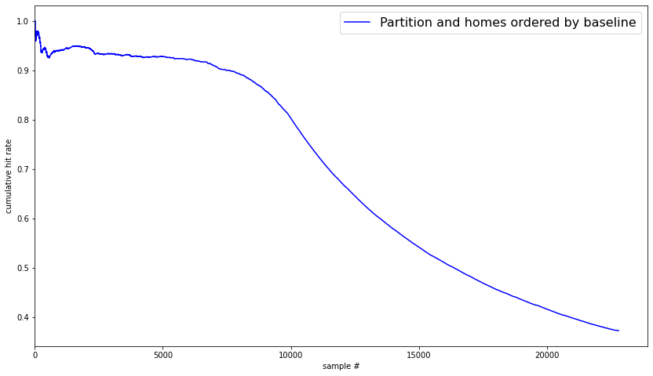
Hex Size = 22

Slide 2
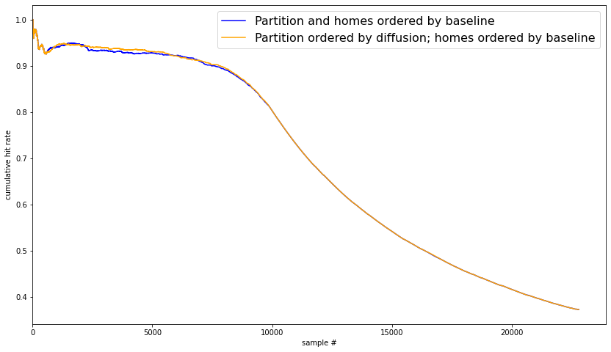
Hex Size = 22

Slide 3
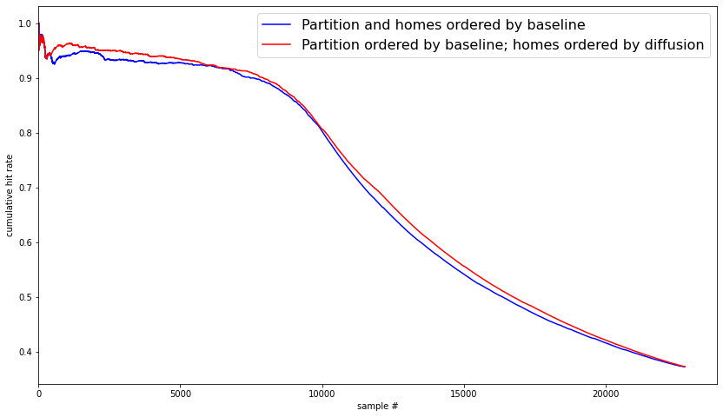
Hex Size = 22

Slide 4
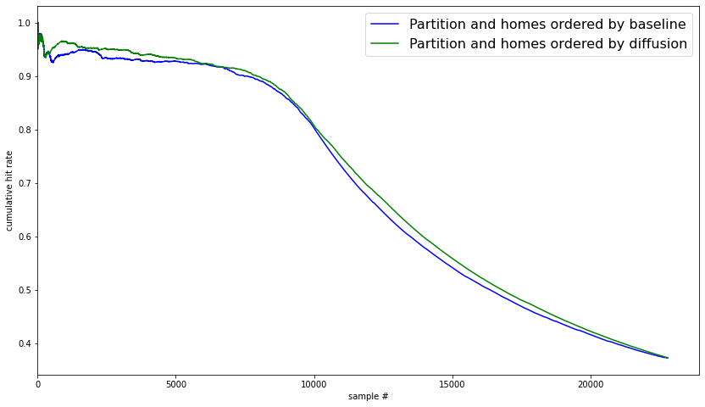
Hex Size = 22

Slide 5
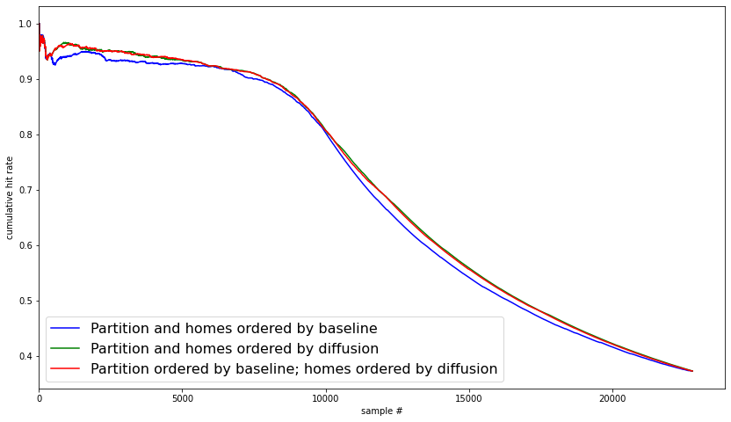
Hex Size = 22

Slide 6

What is going on?

Slide 7

What is going on?

Slide 8
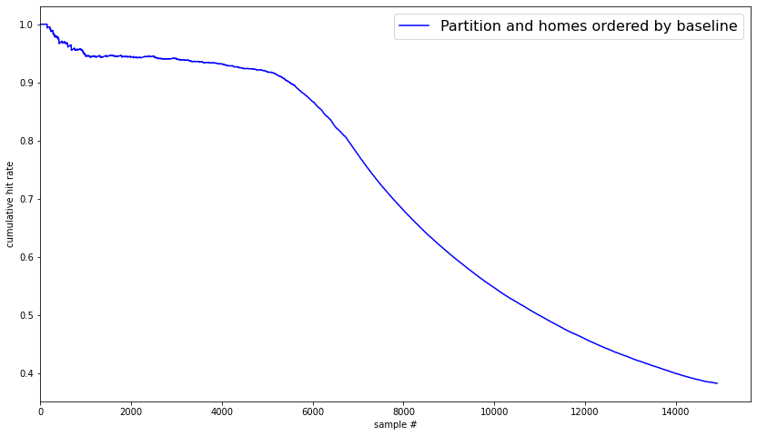
Hex Size = 99

Slide 9
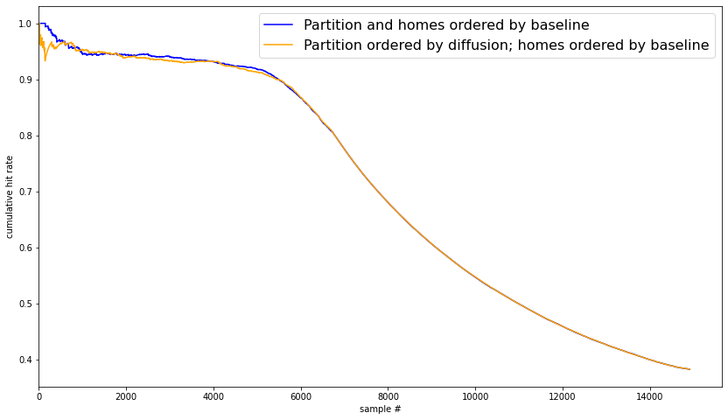
Hex Size = 99

Slide 10
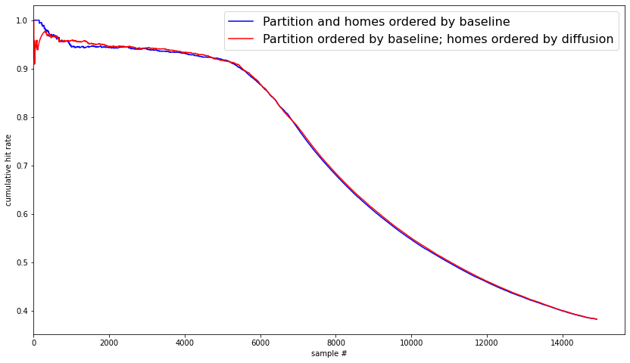
Hex Size = 99

Slide 11
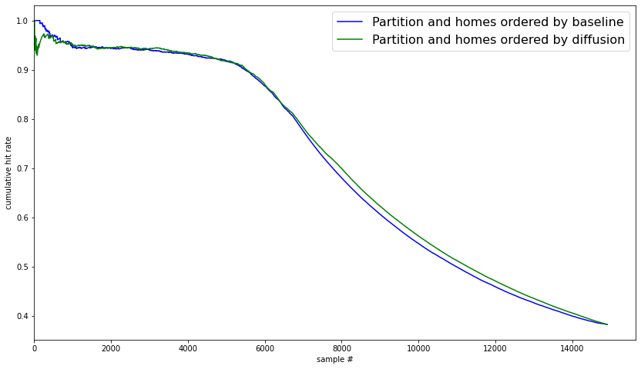
Hex Size = 99

Slide 12
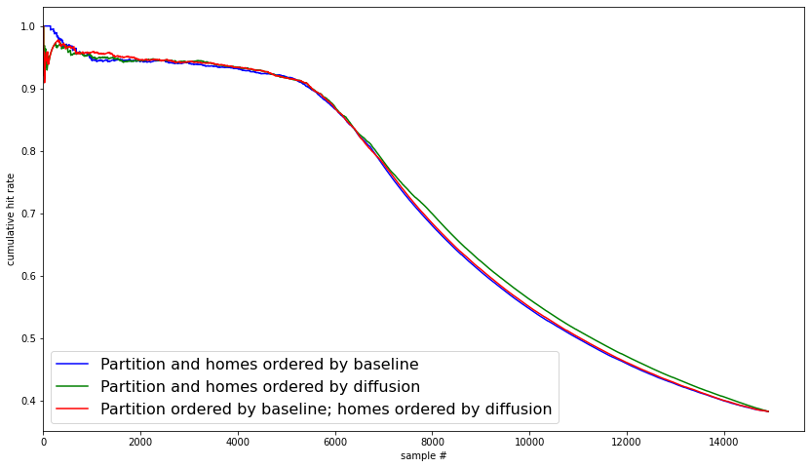
Hex Size = 99

